Slide 1
SAP Business Objects Data Services Day 4

Slide 2
Day 3 Recap
We covered the following topics on Day 3 :
SAP BODS Transforms Overview
Platform Transforms

Slide 3
Agenda - Day 4
Data Integrator Transforms
Table Comparison Transform
Key Generation Transform
History Preserving Transform
Pivot Transform (Columns to Rows)
Reverse Pivot Transform (Rows to Columns)
Date Generation Transform

Slide 4
Data Integrator Transforms

Slide 5

Table Comparison Transform
Compares two data sets and produces the difference between them as a data set with rows flagged as INSERT, UPDATE or DELETE.
The Table_Comparison transform allows you to detect and forward changes that have occurred since the last time a target was updated.
Allows you to identify changes to a target table for incremental updates.
Three possible outcomes from this transform:
New record can be appended
Existing record can be updated
Records can be deleted

Slide 6
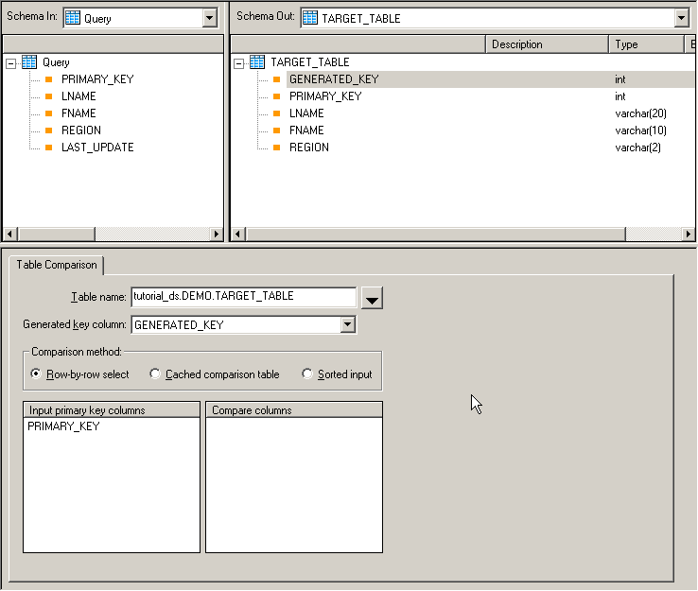
Table Comparison Transform (Cont.)
Presence of output columns indicates proper configuration
Comparison table (usually the target)

Slide 7

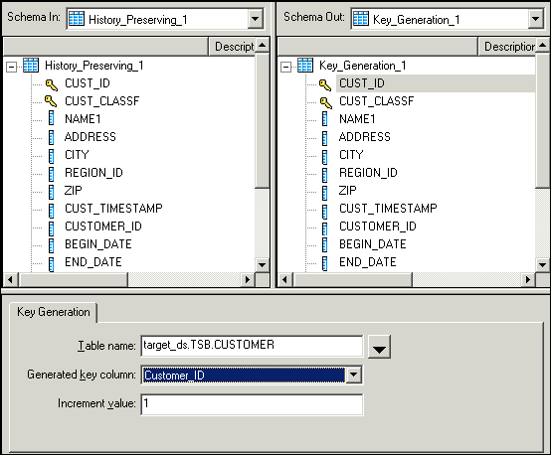
Key Generation Transform
Generates sequential key values for new rows, starting from the maximum existing key value in a specified table
Allows you to build a new physical primary key, e.g. for preserving history
When it is necessary to generate artificial keys in a table, the Key_Generation transform looks up the maximum existing key value from a table and uses it as the starting value to generate new keys.
The transform expects the generated key column to be part of the input schema.

Slide 8

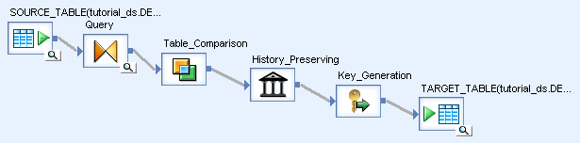
History Preserving Transform
The History_Preserving transform allows you to produce a new row in your target rather than updating an existing row. You can indicate in which columns the transform identifies changes to be preserved.
The History_Preserving transform requires input rows flagged as INSERT or UPDATE.
The History_Preserving transform is usually preceded by a Table_Comparison, which provides the required input row types.

Slide 9

Pivot Transform (Columns to Rows)
Creates a new row for each value in a column that you identify as a pivot column.
The Pivot transform allows you to change how the relationship between rows is displayed.
For each value in each pivot column, Data Services produces a row in the output data set.
You can create pivot sets to specify more than one pivot column.
Input:
Output:
Name | Jan | Feb | Mar
Joe | 1100 | 500 | 900
Sid | 500 | 1200 | 300
Dolly | 900 | 1300 | 200
Name0 | Sequence | Month | Q1
Joe | 1 | Jan | 1100
Joe | 2 | Feb | 500
Joe | 3 | Mar | 900
Sid | 1 | Jan | 500
Sid | 2 | Feb | 1200
Sid | 3 | Mar | 300
Dolly | 1 | Jan | 900
Dolly | 2 | Feb | 1300
Dolly | 3 | Mar | 200
Non Pivot columns: Name Pivot columns: Jan, Feb, Mar Sequence name: Sequence Pivot data field: Q1_Expenses Pivot header name: Month

Slide 10

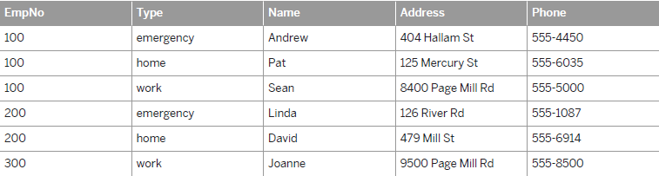
Reverse Pivot Transform (Rows to Columns)
Creates one row of data from several existing rows.
The Reverse Pivot transform allows you to combine data from several rows into one row by creating new columns.
For each unique value in a pivot axis column and each selected pivot column, Data Services produces a column in the output data set.

Slide 11
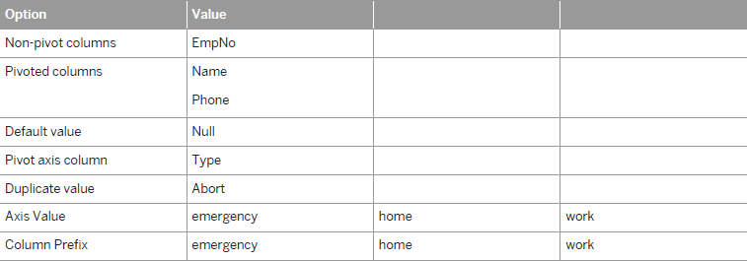
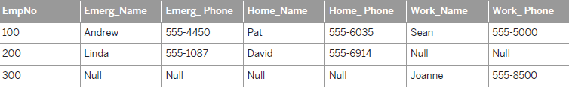
Reverse Pivot Transform (Rows to Columns) (Cont.)
Input:
Output:

Slide 12

Date Generation Transform
Produces a series of dates incremented as you specify.
Use this transform to produce the key values for a time dimension target.
From this generated sequence you can populate other fields in the time dimension (such as day_of_week) using functions in a query.
For Example: To create a time dimension target with dates from the beginning of the year 1997 to the end of the year 2000, place a Date_Generation transform, a query, and a target in a data flow. Inside the Date_Generation transform, specify the following Options :
Start date: 1997.01.01
End date: 2000.12.31 (A variable can also be used.)
Increment: Daily (A variable can also be used.)

Slide 13

Q&A

Slide 14
Thank You

